Slide 1

Ishita Mohindra
Ankit Nagda
Pranit Mhatre
CSCI-588 - SPECIFICATION AND DESIGN OF USER INTERFACE SOFTWARE

Slide 2
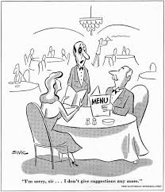
Why??

Slide 3
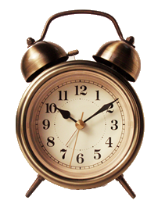
What Makes us Tick?
Reduced wait time in the restaurant
Updated menu items to choose from your table
M-commerce
Independence

Slide 4
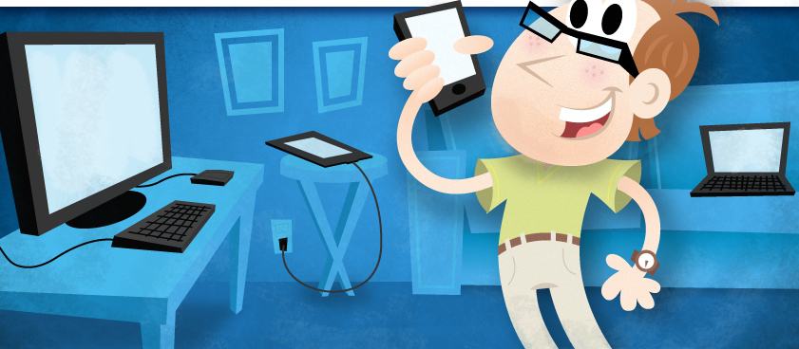
What makes us Different?
Making use of the smartphones for the smart use.
User becomes independent of the customary wait at the restaurant at all levels.
Saves a lot of time and enables user to do the job using his personal device, starting from order to payment.

Slide 5
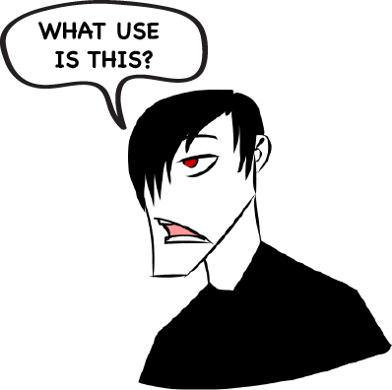
What is our Point?
We aim to make the process of ordering food in the restaurant smooth and “wait free”
The quick process increases not just the sales of the restaurant but also reduces the frustration of the user while waiting for food.
You know what I mean! Don’t you? If not then this would look familiar…

Slide 6
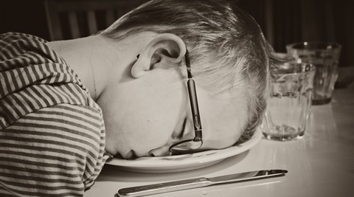
Sad… ☹

Slide 7
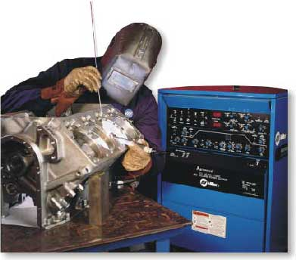
What Technology is this?
NFC: Near Field Communication (Listen up!)
We have the Android handheld smart phone that is used to place the order and check in.
We have the Android Tablet that confirms the order and send the permit to proceed with the order once the user successfully checks in.
We plan to make use of the M-Commerce (either Paypal API or our own SSL gateway to process payments)

Slide 8
What DID it look like?
Put important white board pics from prototype that show basic function.

Slide 9
What DOES it look like?
Import screen shots from phone and tablet.

Slide 10
What is really going on?
Step 1: User Books a table from the hand held device
Step 2: He gets a text confirmation
Step 3: He checks in using the NFC in the restaurant
Step 4: He orders the food and it gets processed
Step 5: He pays the bill Using his smartphone
Step 6: He leaves the place… happily ever after!

Slide 11

Will we show the Demo now?
YES! Of Course…

Slide 12
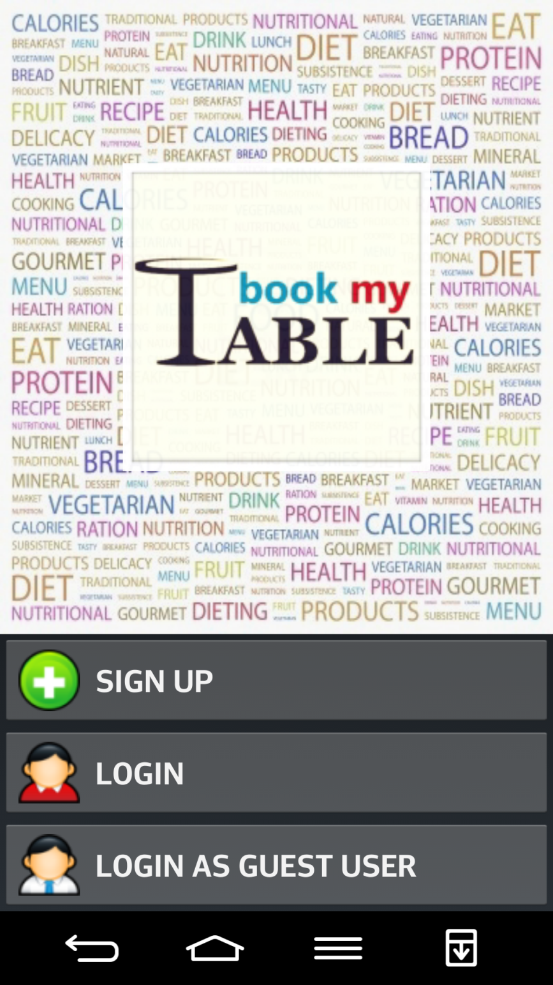
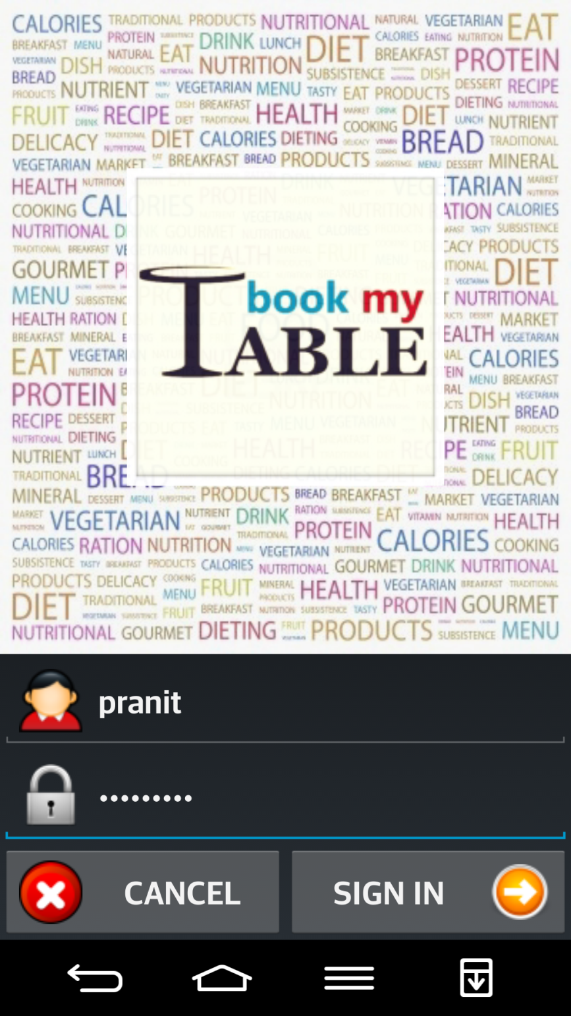

Slide 13
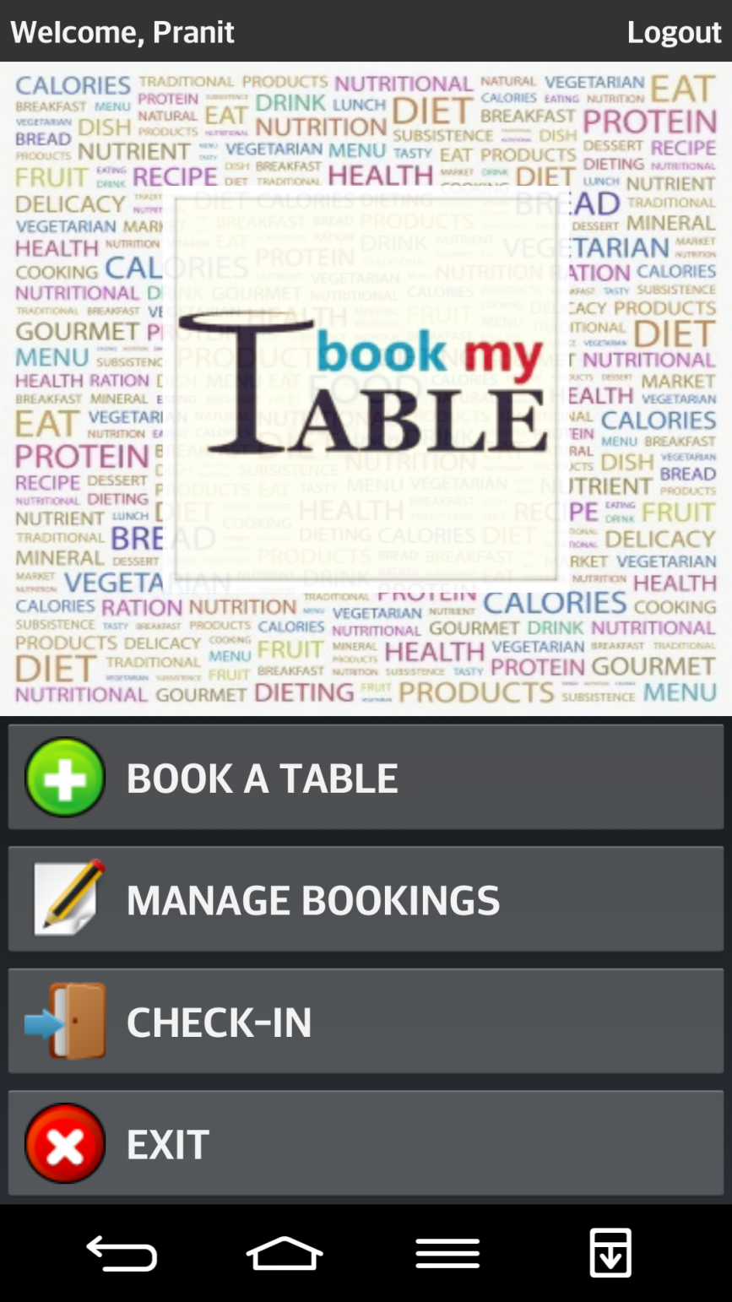
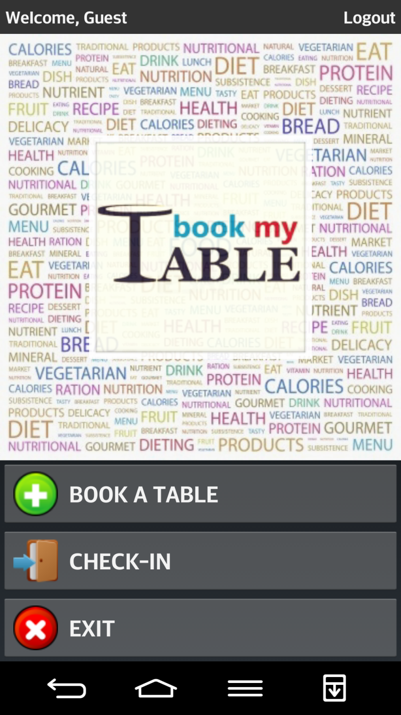

Slide 14
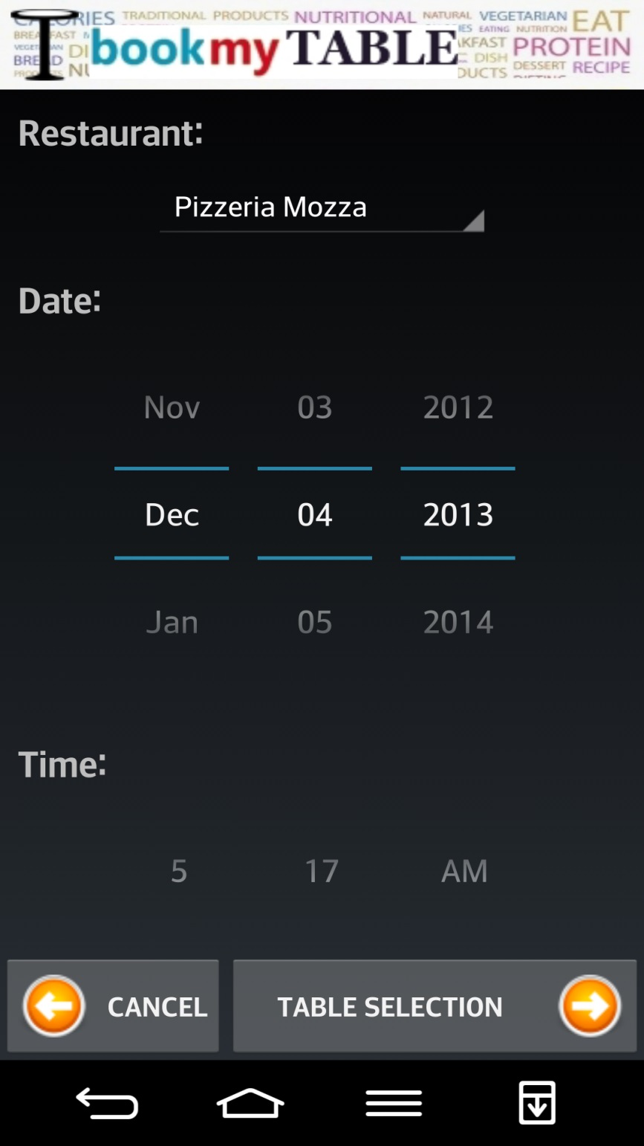
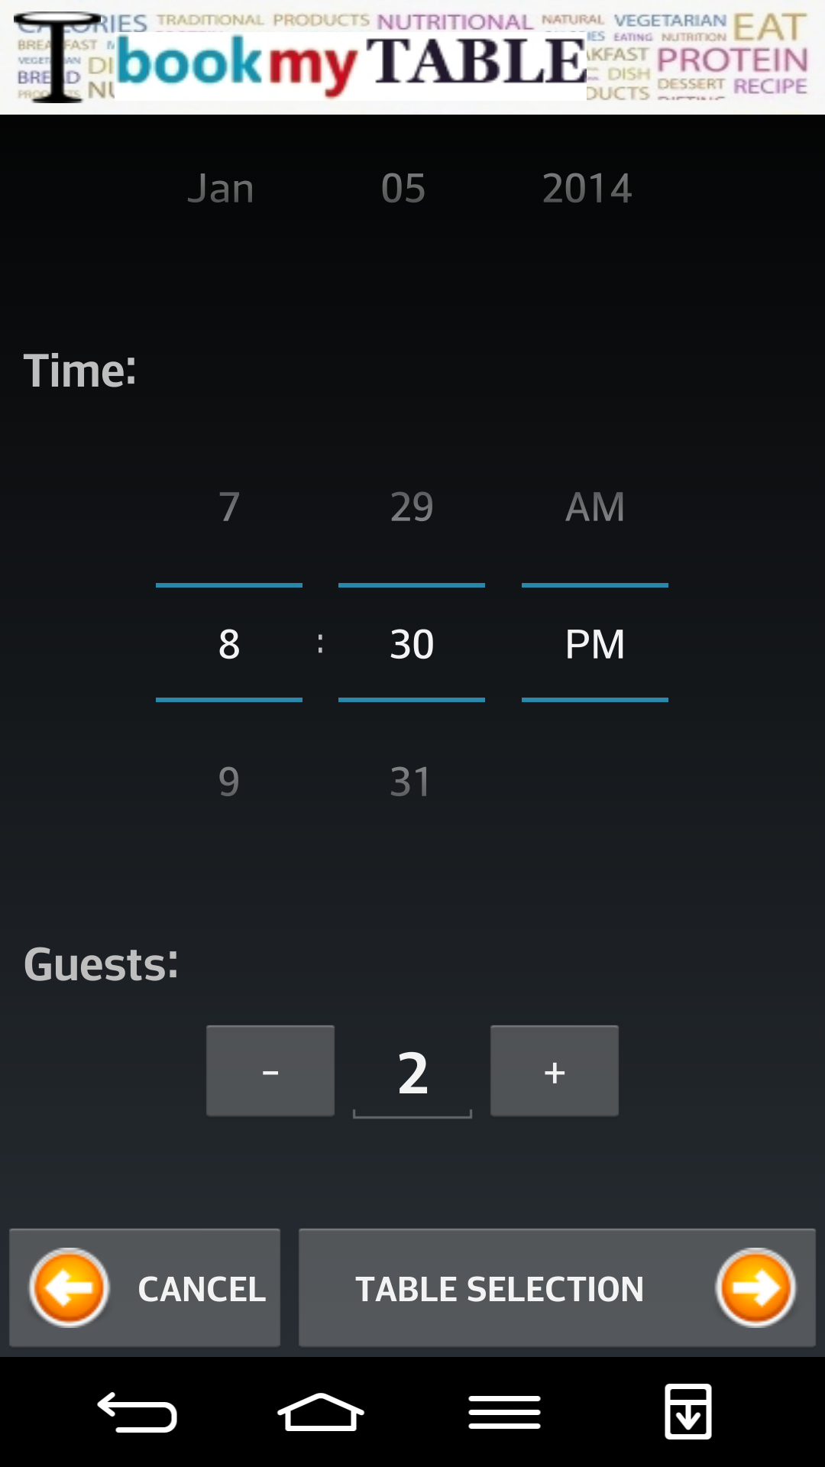

Slide 15
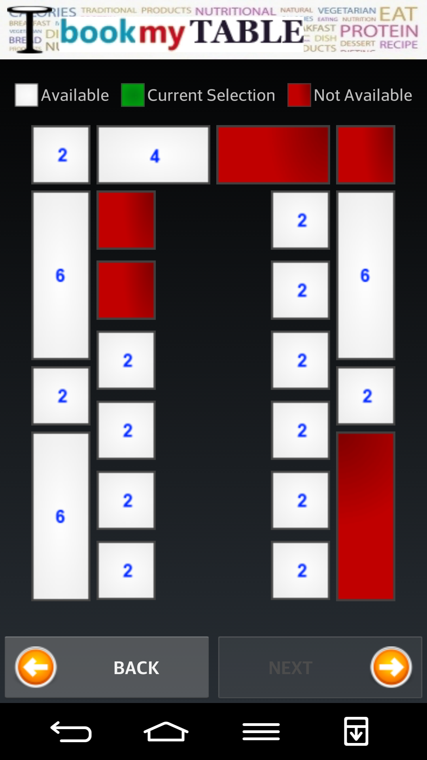
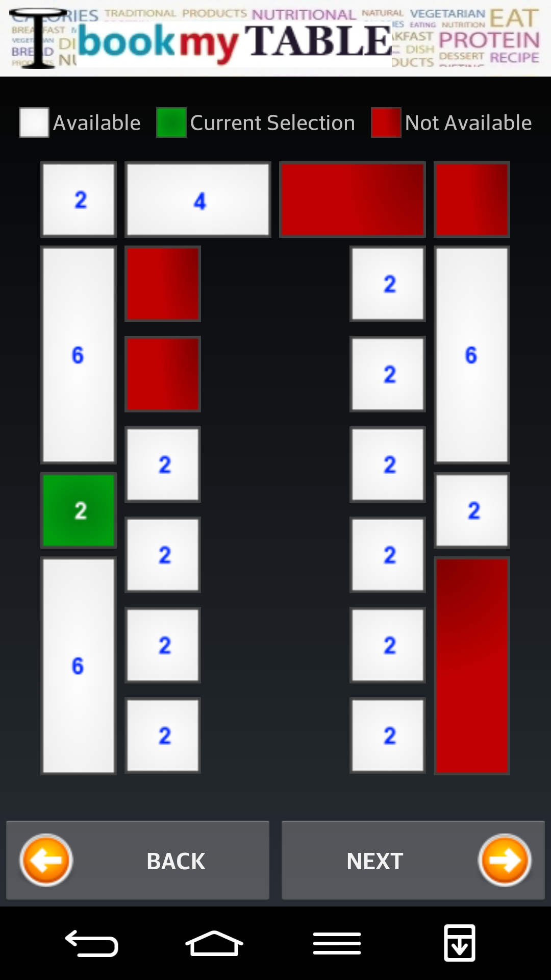

Slide 16
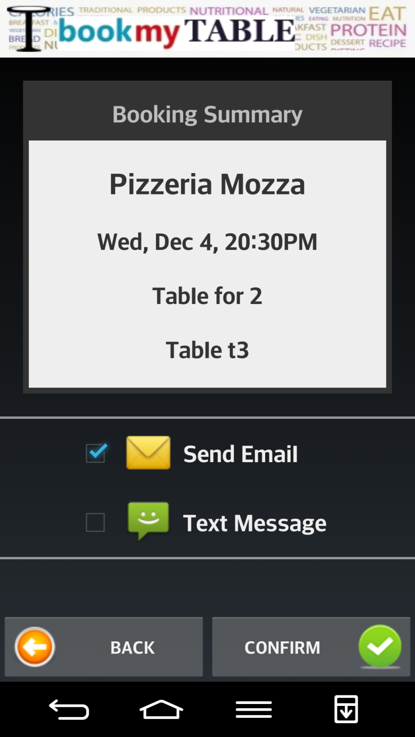
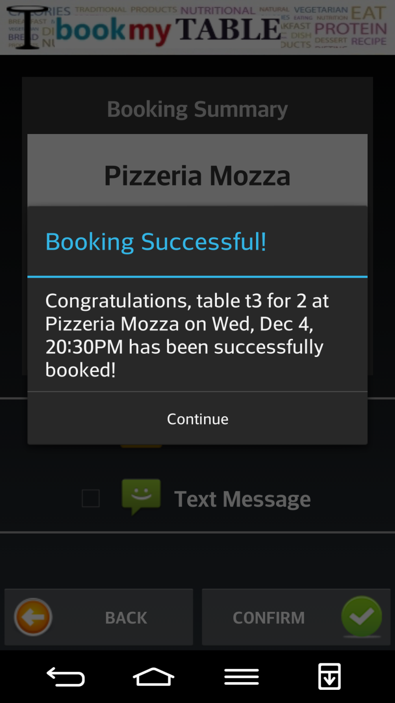

Slide 17
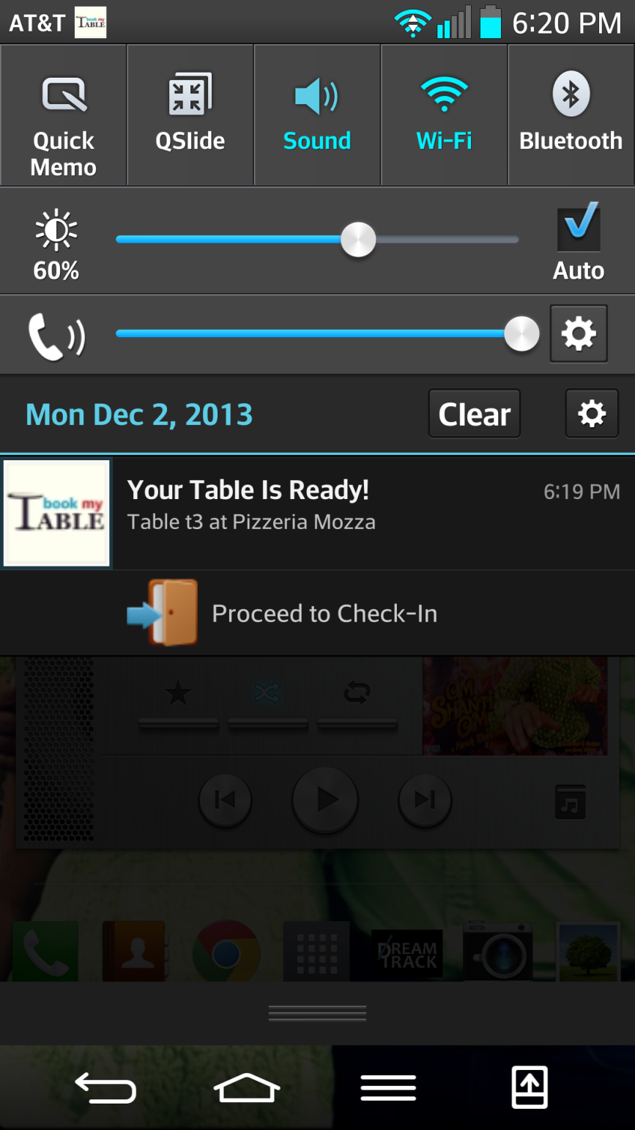

Slide 18
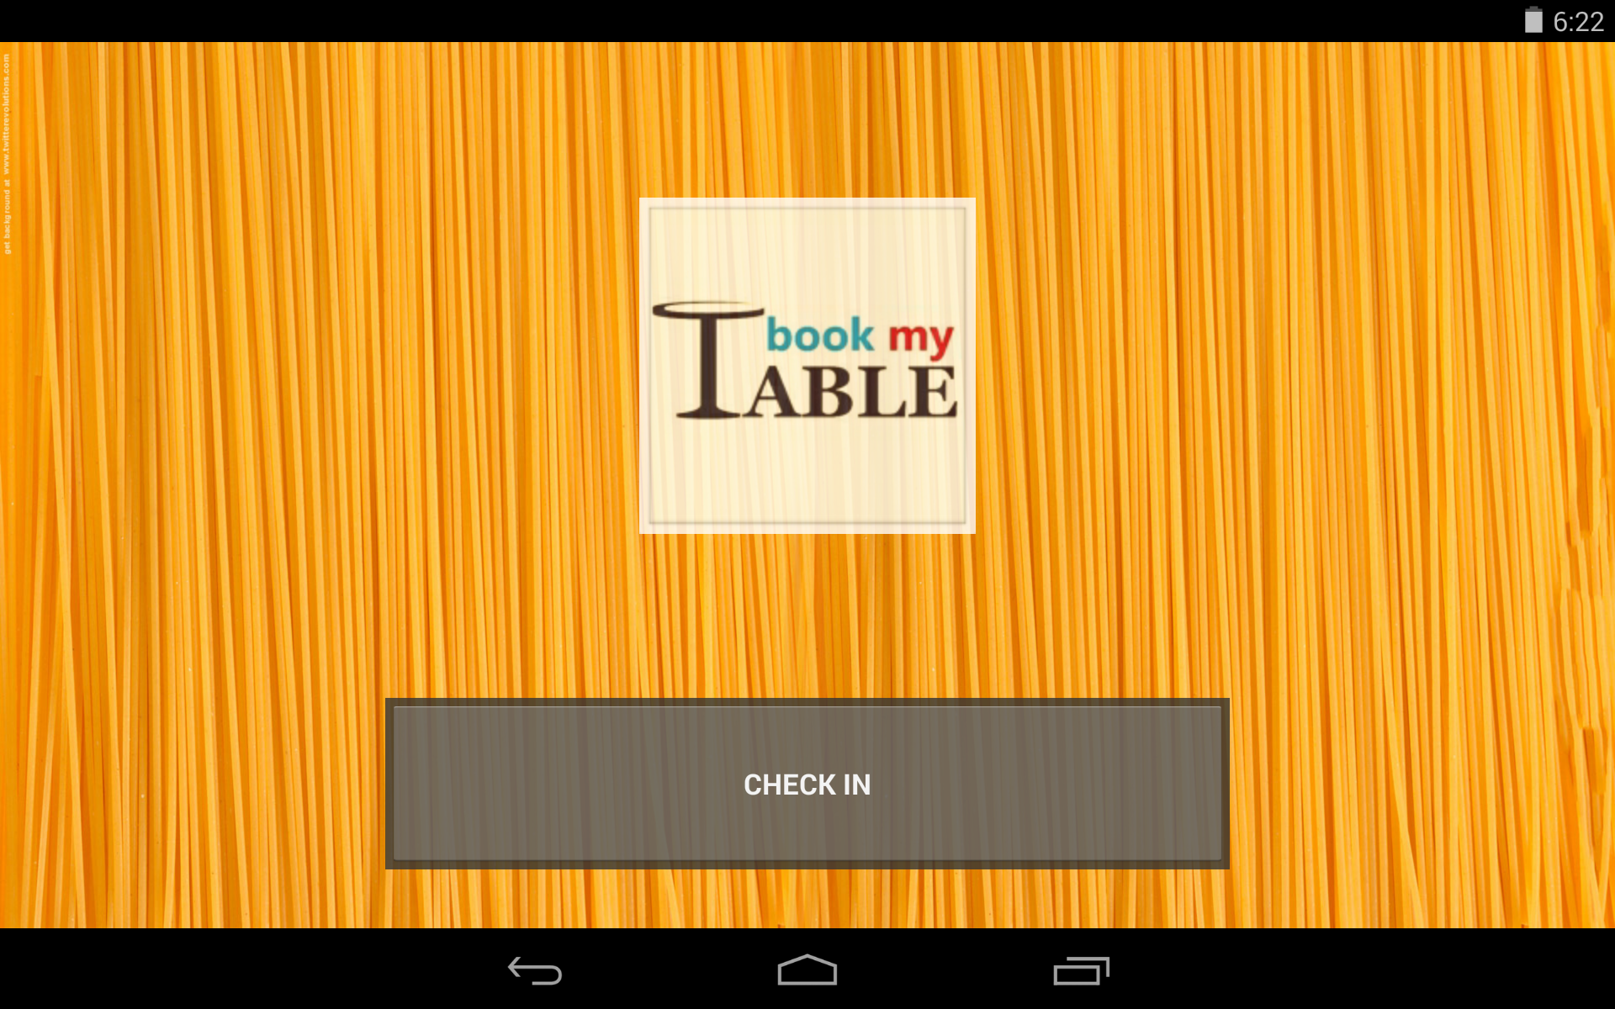

Slide 19
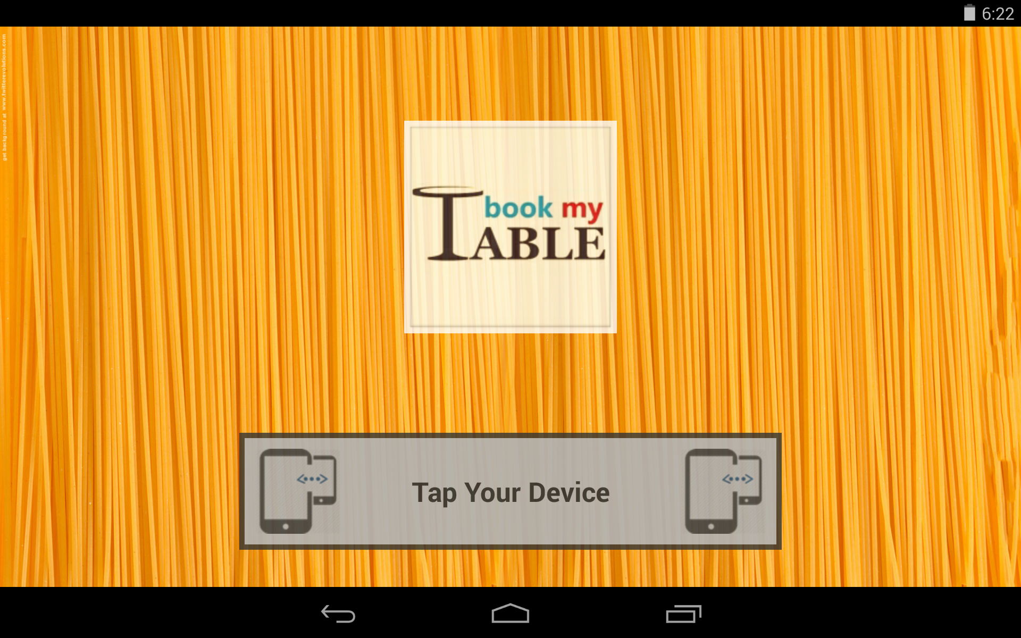

Slide 20
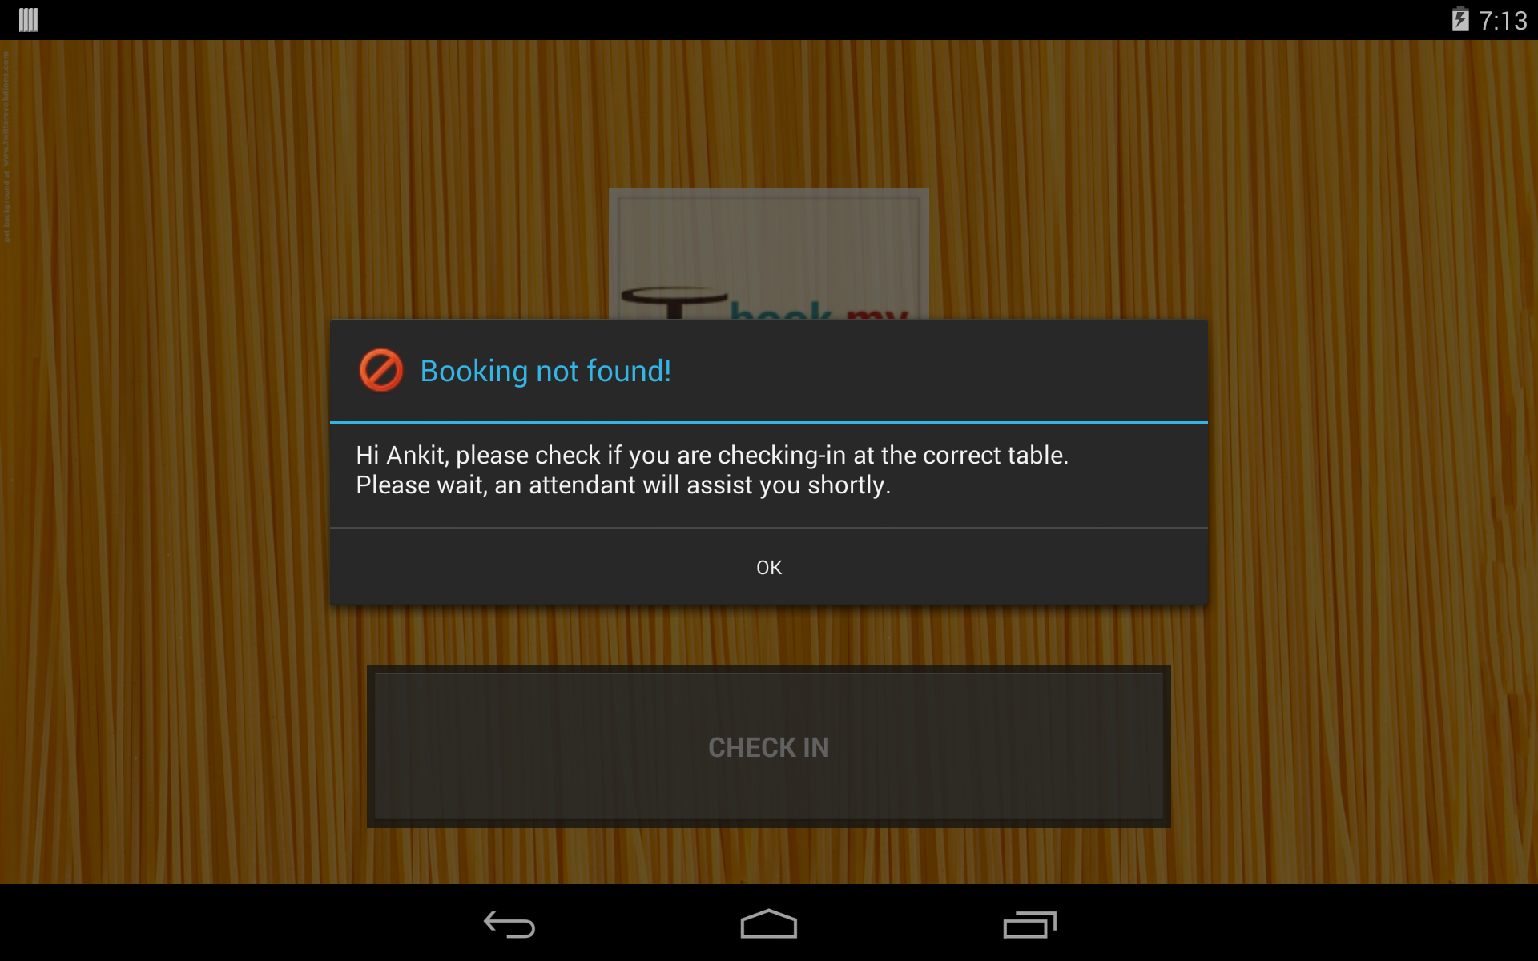

Slide 21
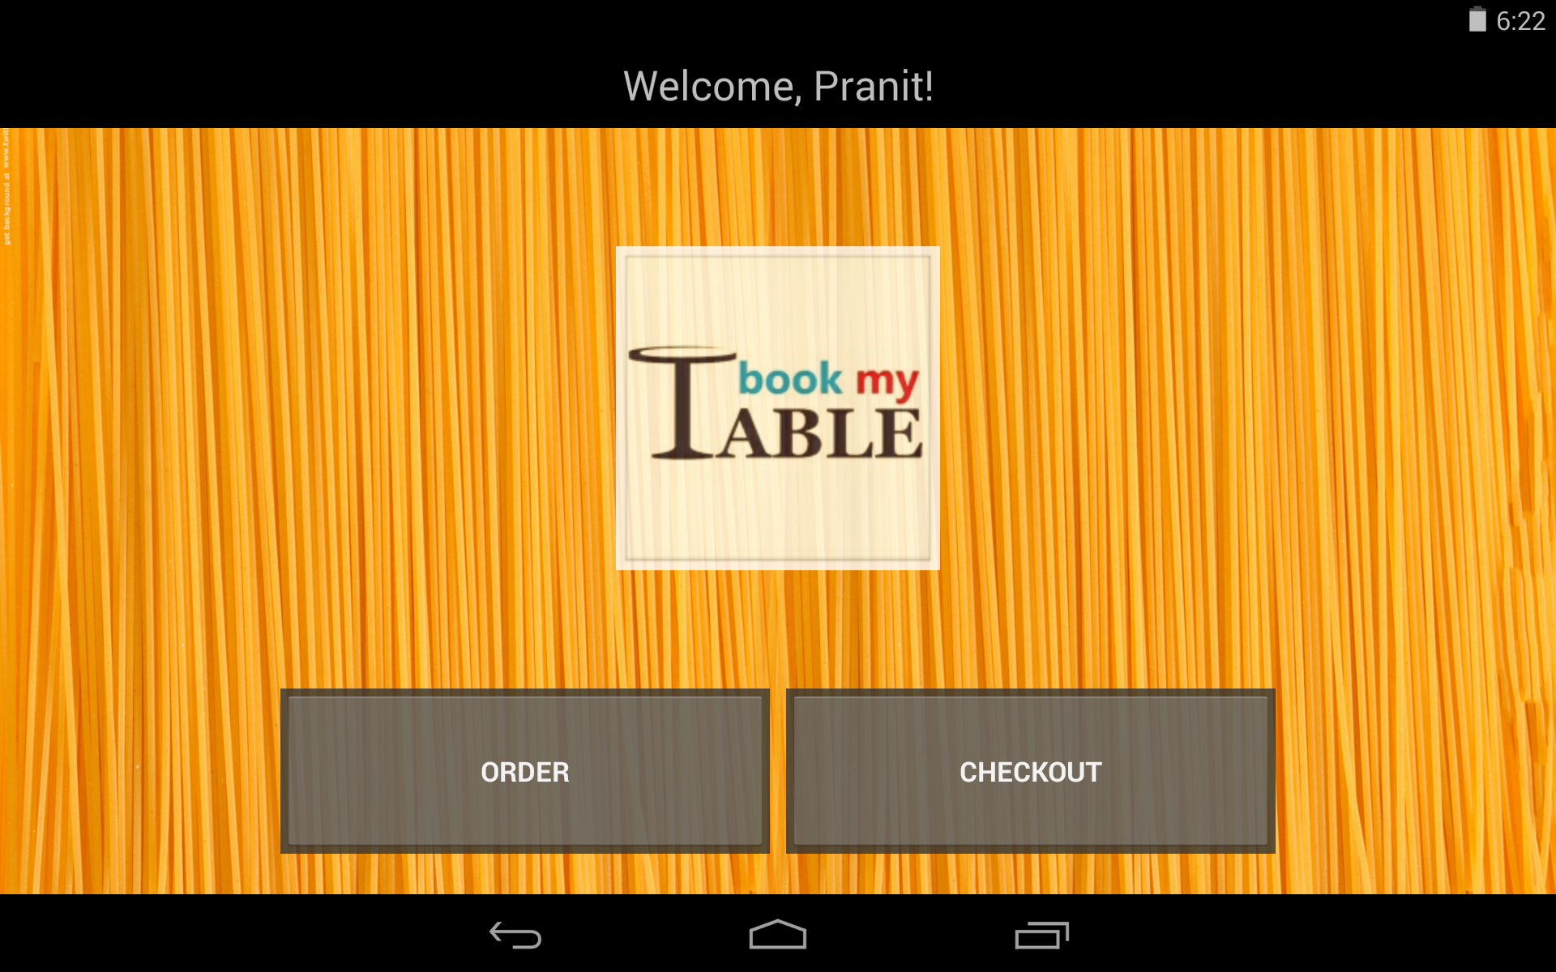

Slide 22
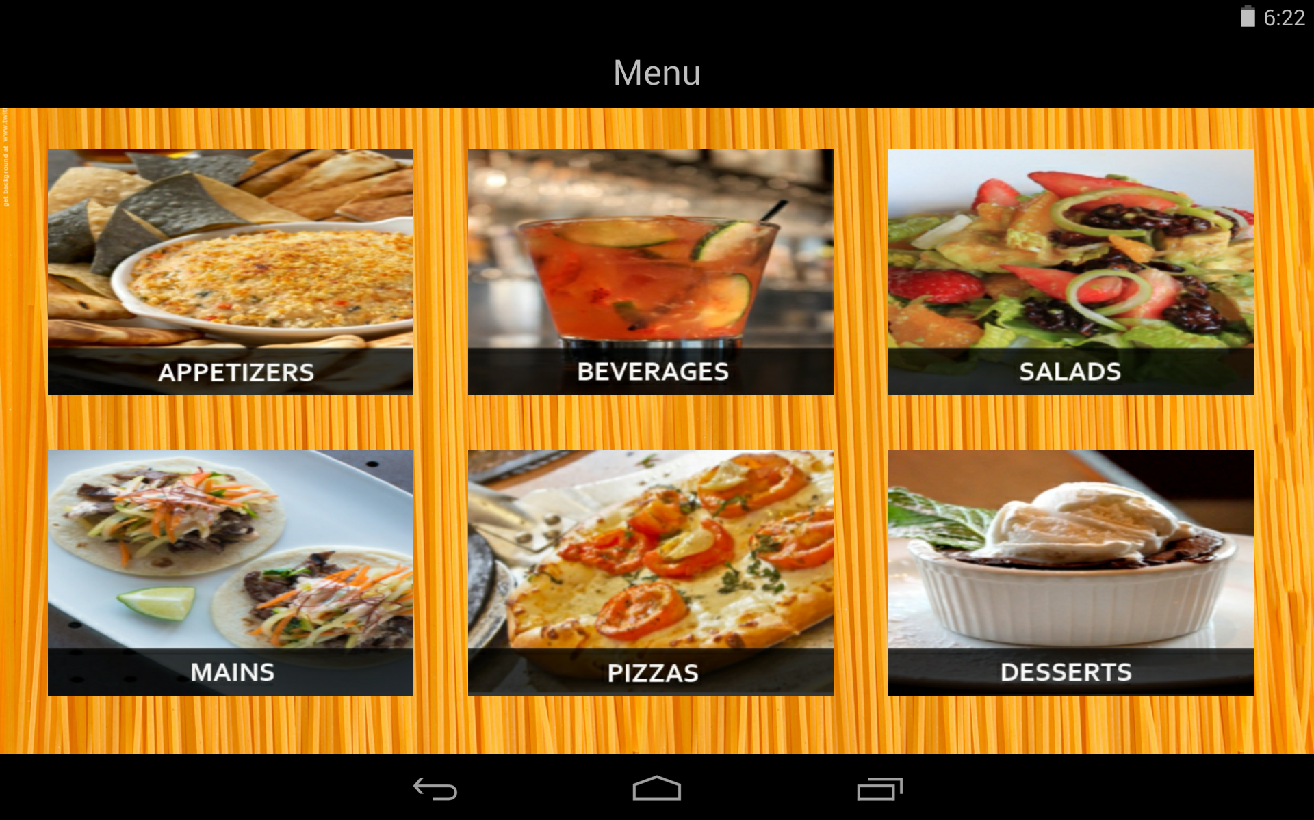

Slide 23
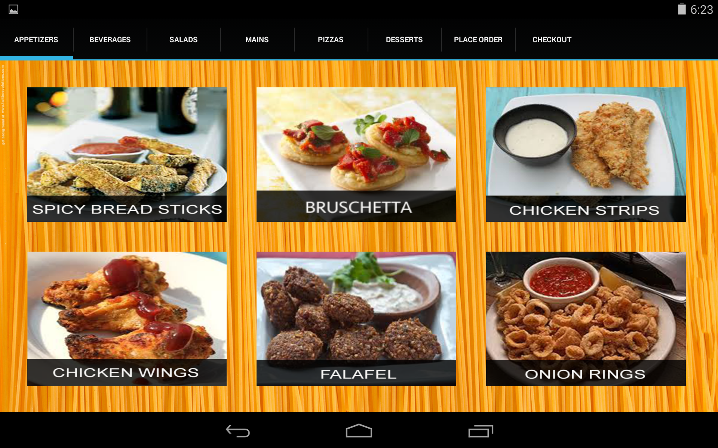

Slide 24
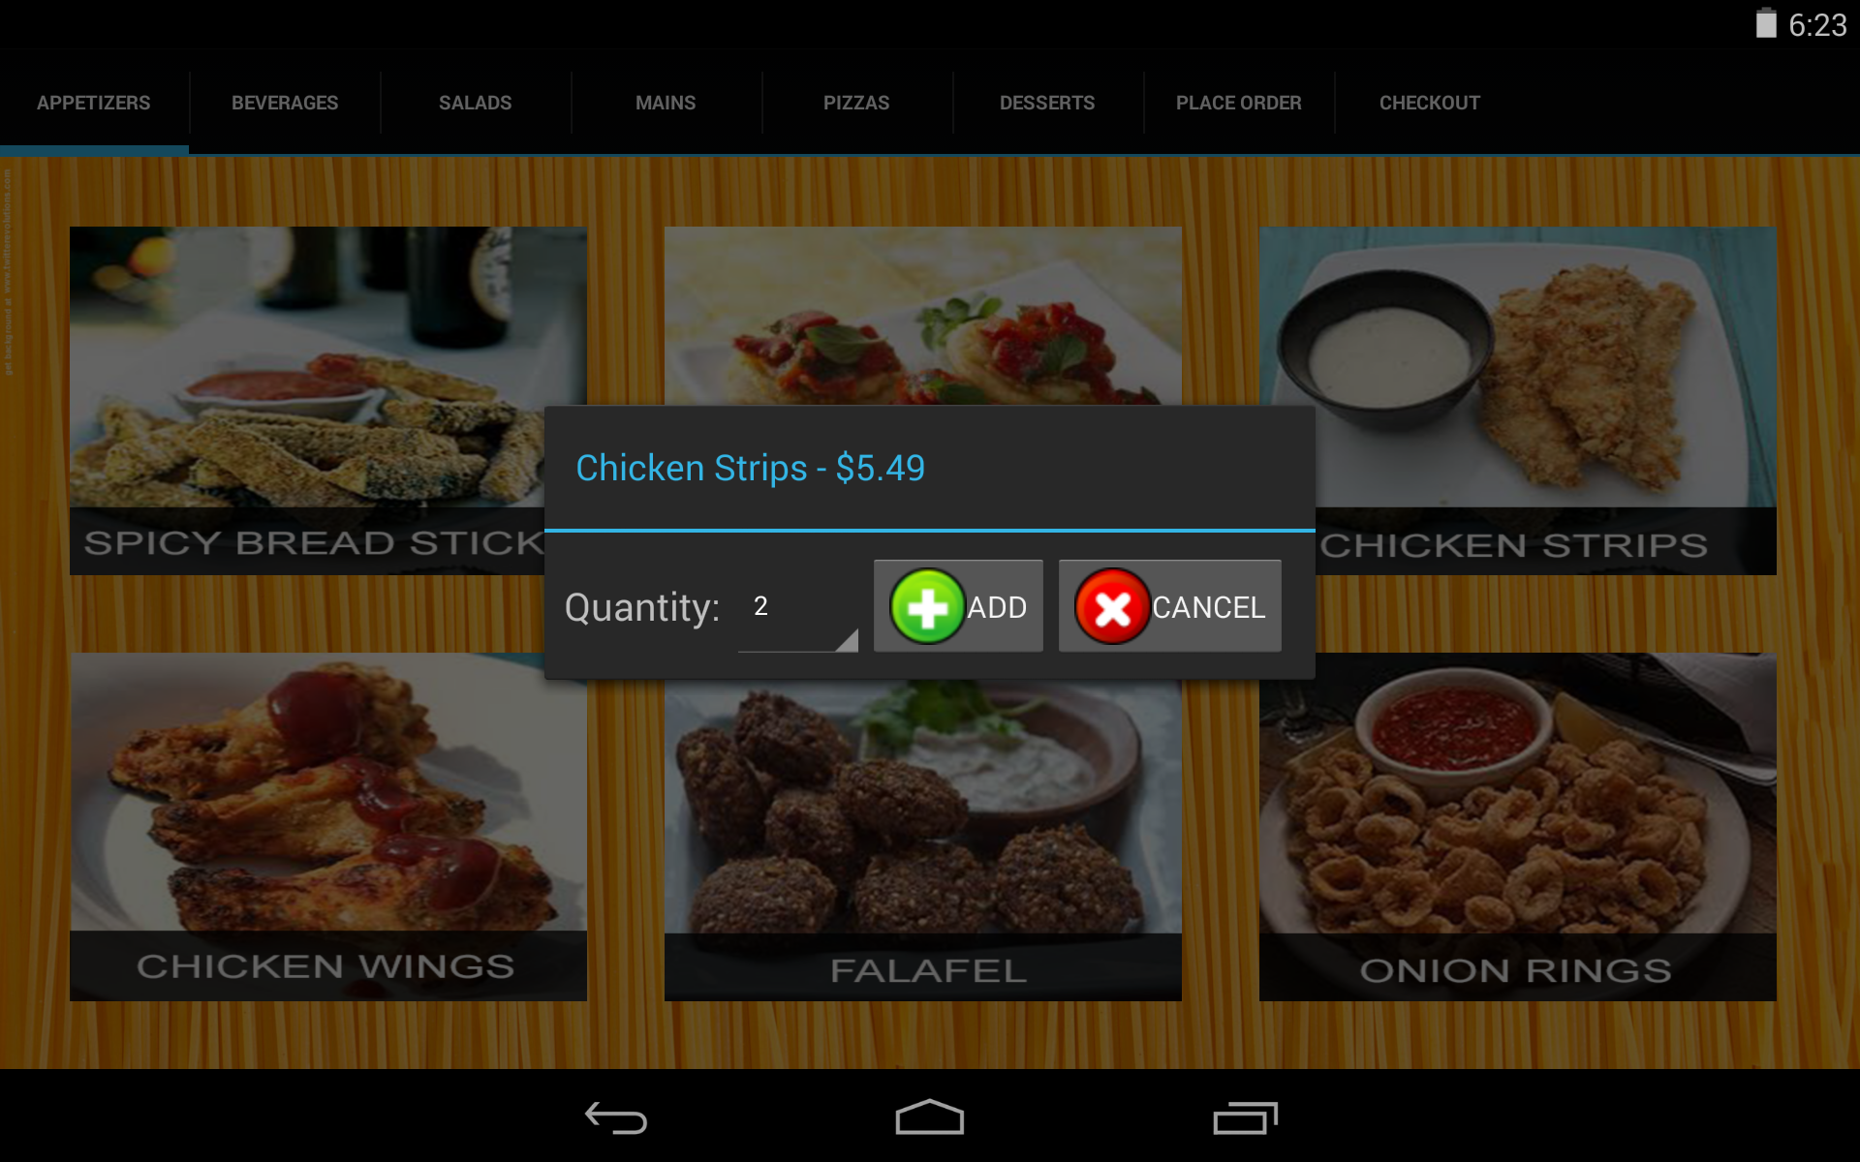

Slide 25
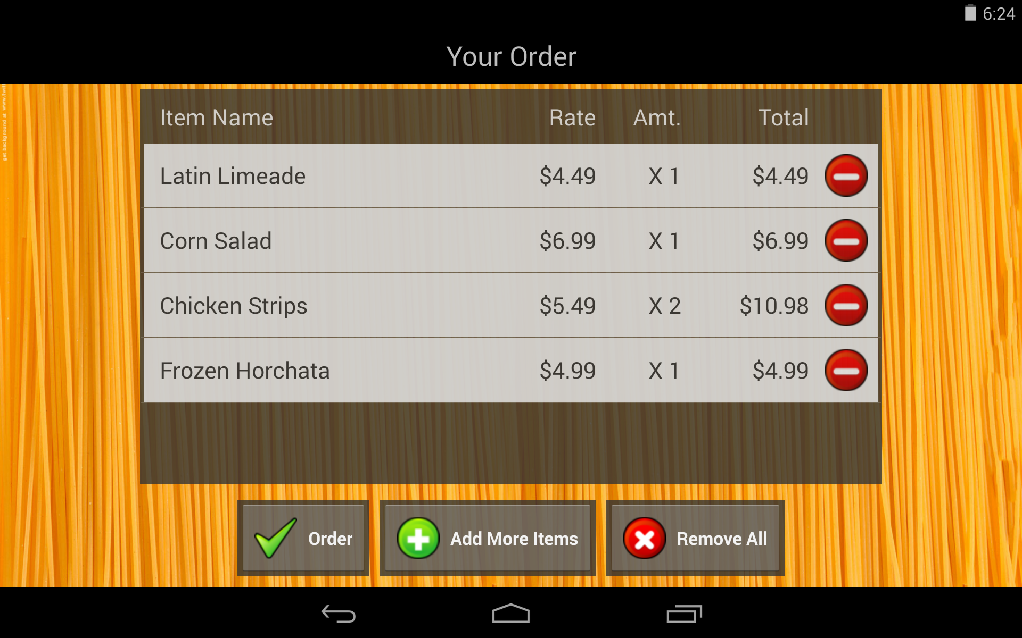

Slide 26
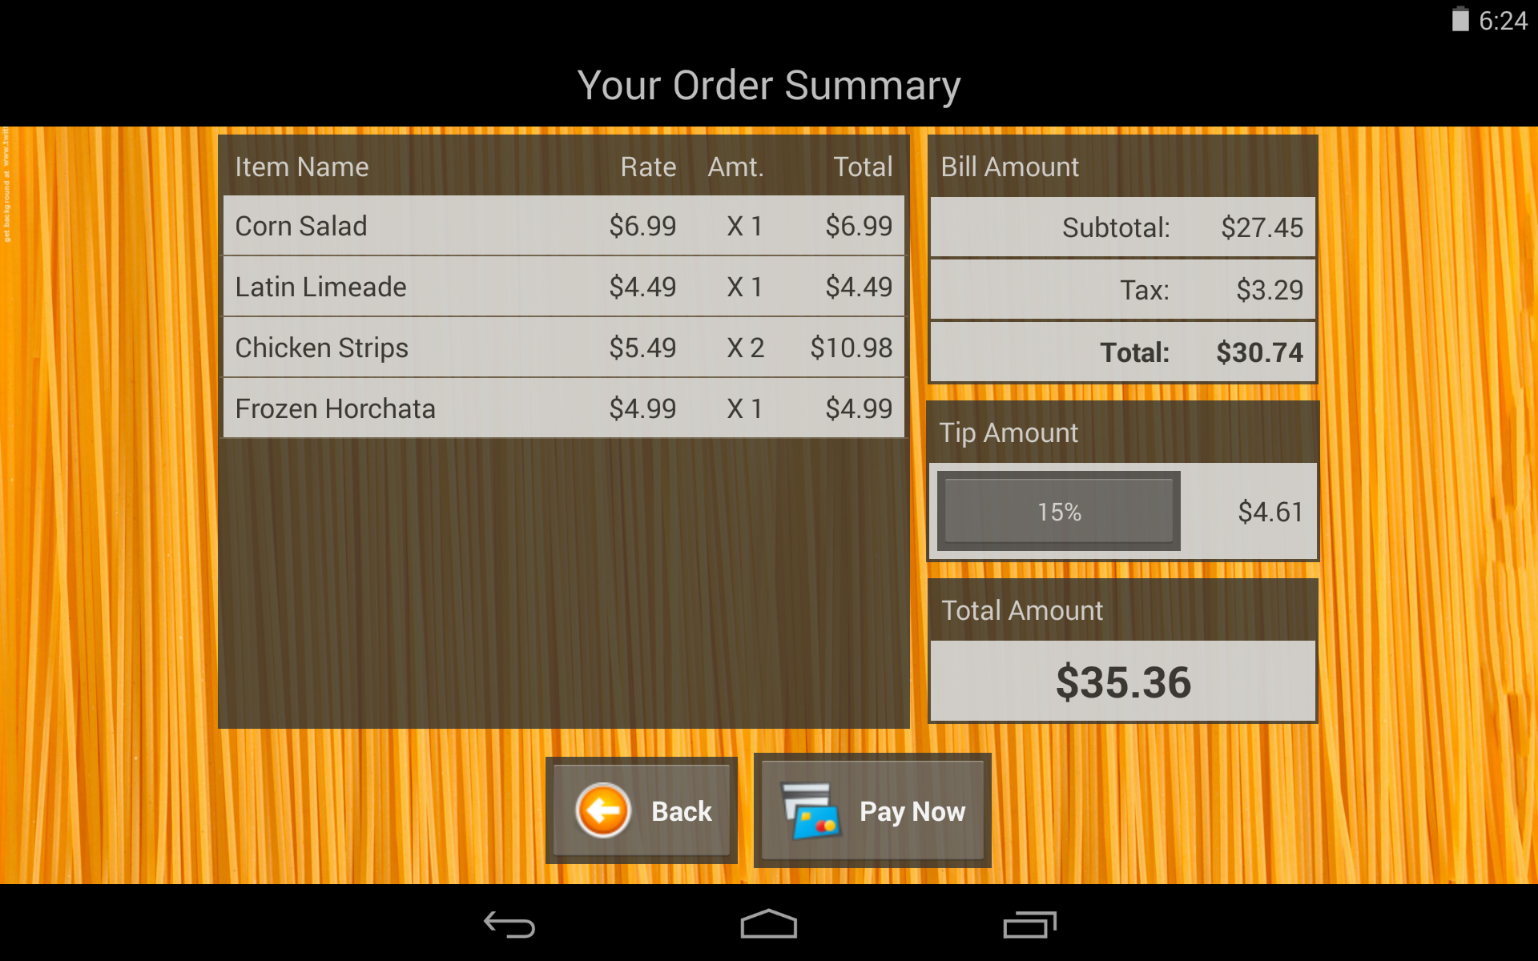

Slide 27
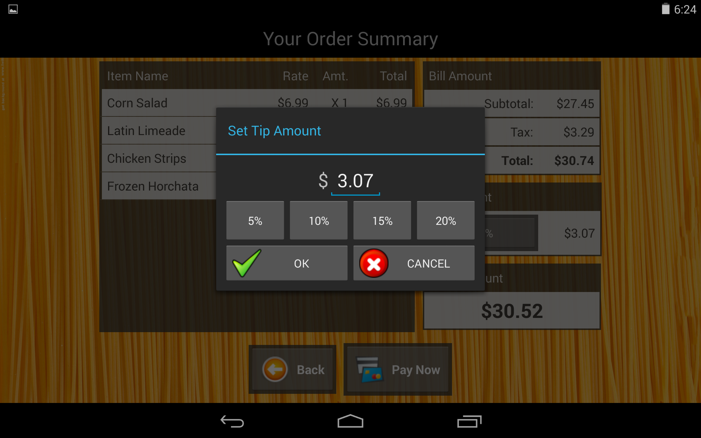

Slide 29
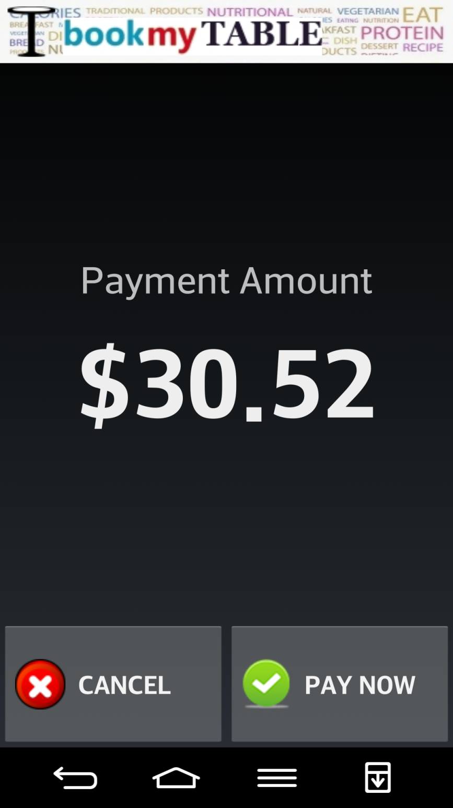
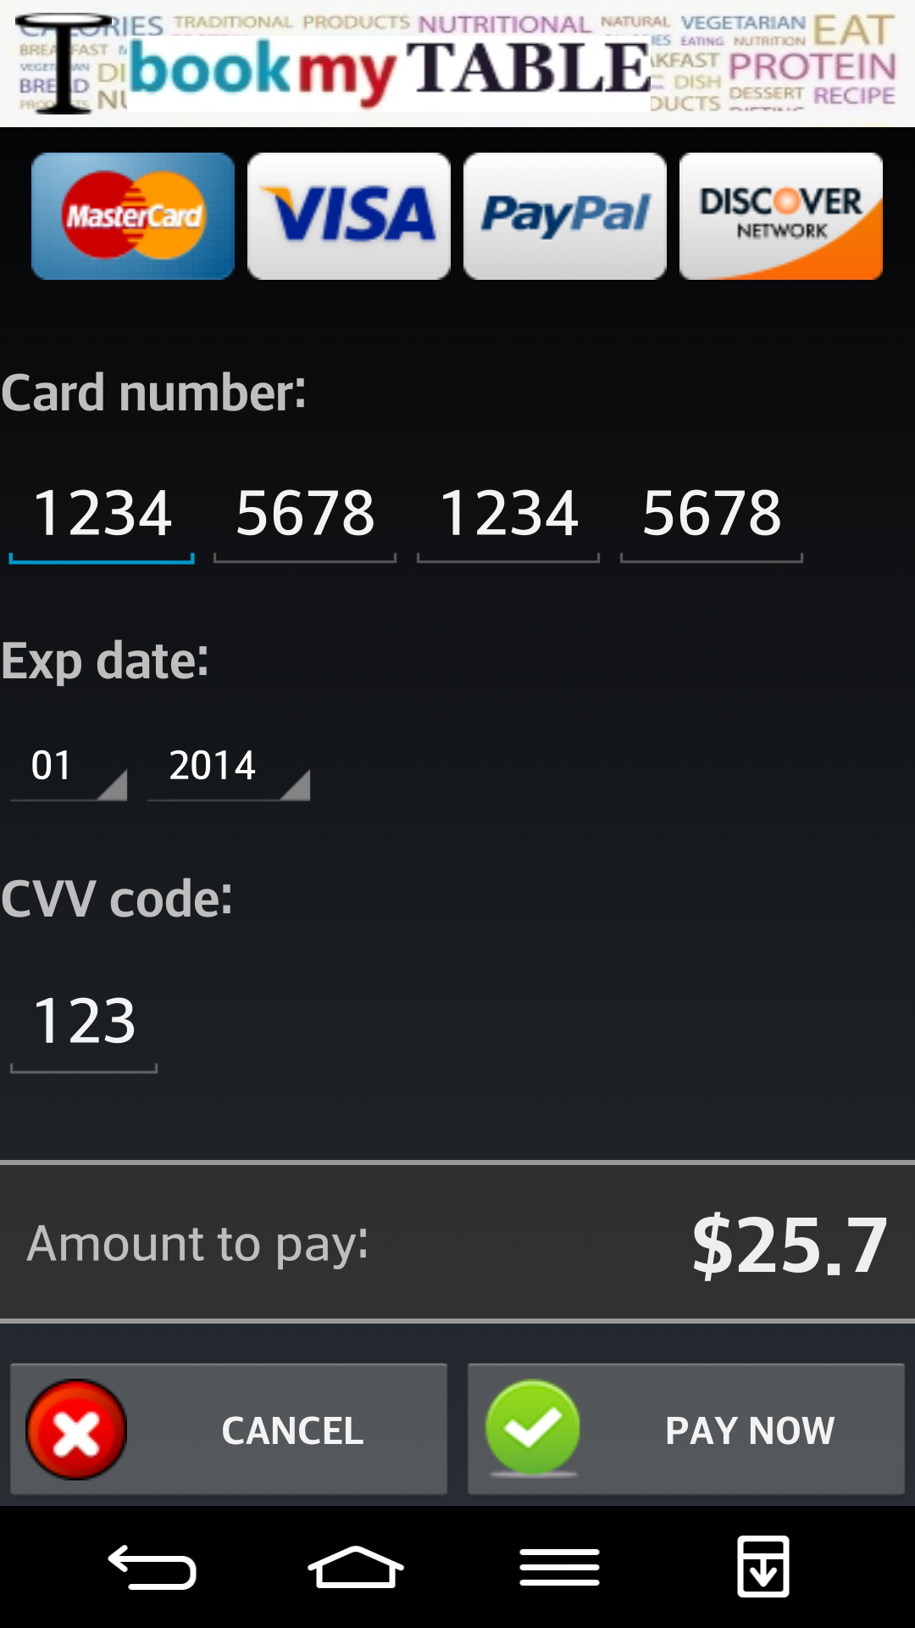

Slide 30
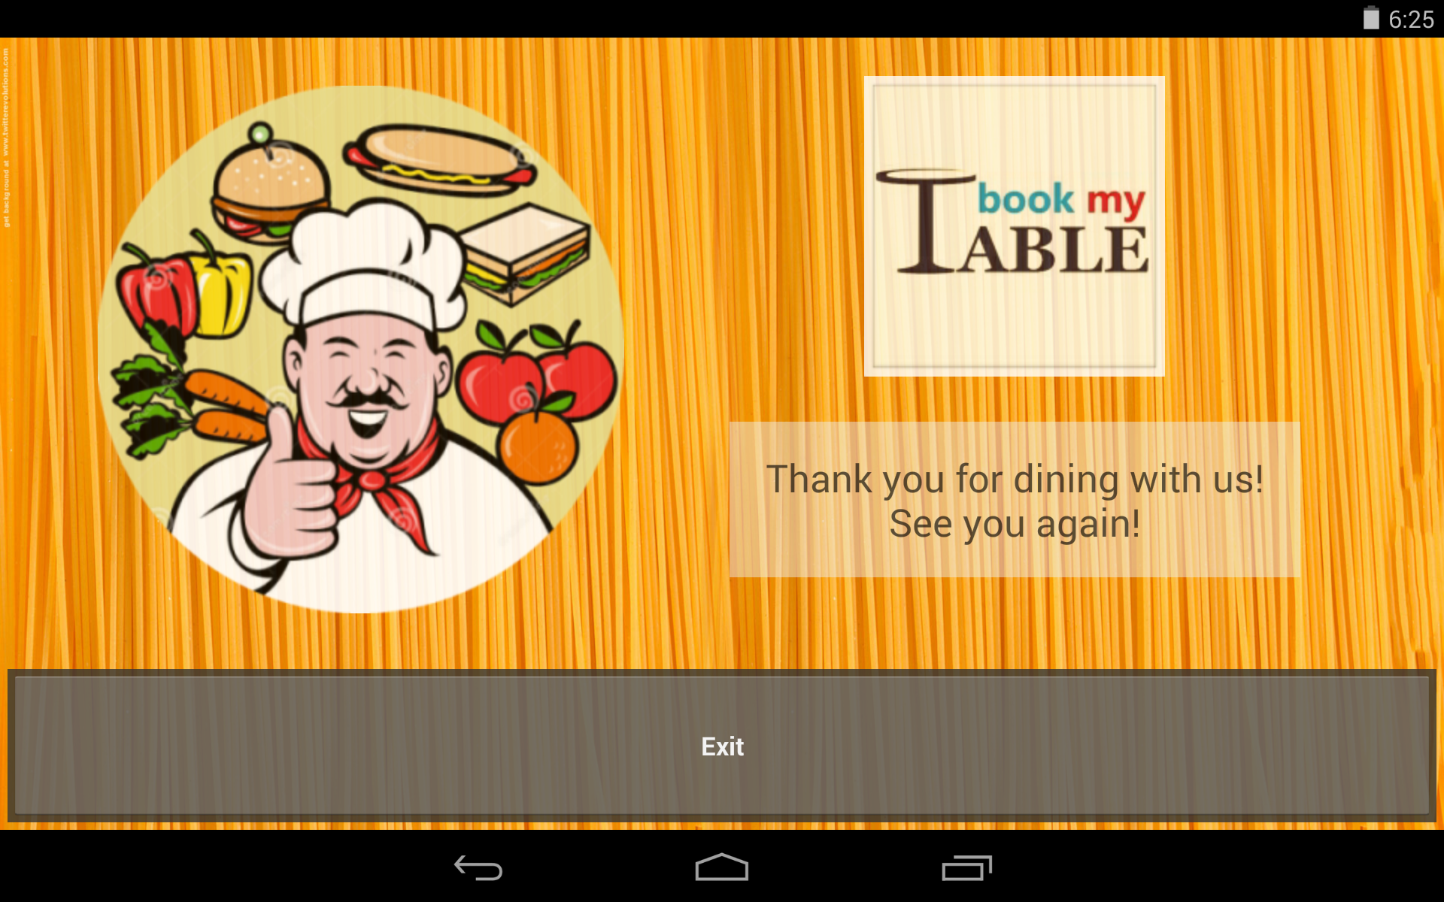

Slide 31

What did the Usability Analysis show?
J. Nielsen has shown that tests achieved with 5 users allow to raise at least 80% of usability problems.

Slide 32

What were the Issues Raised?
The analysis showed the below listed results:
The usage of colors initially was too bright – fixed
The swipe with tabs wasn’t explicit – fixed
Some users were confused as to why order and checkout were together but we have kept this way so one can re order after orders and if you try to checkout before you order you can be informed.

Slide 33
What is our HTA?

Slide 34
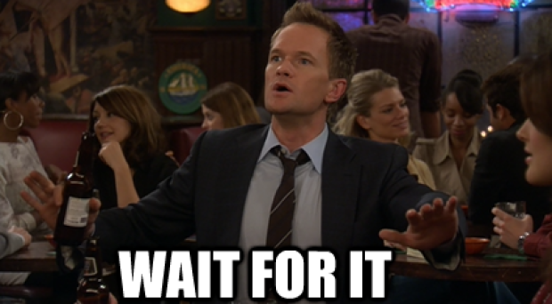
So Don’t get tired and…
Go Smart.
Use Book My Table!

Slide 35
THANK YOU ☺

